Slide 1
Application frameworks
React JS

Slide 2

Overview
React JS
Notable features
Props and State
Component life cycle
Context
Hooks
Babel
Webpack
Parcel
Let’s try this out
Setting up

Slide 3
React JS
Developed and maintained by Facebook and Instagram.
A JavaScript library for creating user interfaces.
Serves as the view of MVC architecture.
Suitable for large web application which use data and change over the time without reloading the entire page.
React Native caters developing mobile application for various platforms and React VR caters developing VR applications.
Aims at Speed, Simplicity and Scalability.

Slide 4
Notable features
One-Way data flow.
Single source of truth - Data is originated and kept in one place, data is immutable.
Data flow from the parent component to the child component.
Action flow from child component to parent component.
Virtual DOM
DOM manipulation is cost instead react create a virtual DOM tree and compare it with the rendered tree and update only what is changed.
JSX
React JS language for defining user interfaces.
HTML/XML like syntax.
Prevents cross-site scripting attacks by converting expressions to strings.

Slide 5
Props and State
Props are used to pass data and behaviors from container components to child components.
Props are read only.
State is used to keep data which can be updated.
State is read write enabled.
Use setState({}) method to update state.
setState method is asynchronous so, if you want to to use state and props inside setState method use the second form of the method setState((state,props)=>{}).

Slide 6
Component life cycle
React components extended from React.Component parent class inherit a set of methods that belong to react lifecycle.
Render and Commit state
Controlled and Uncontrolled components.
Managing side effects.
constructor
render
componentDidMount
componentDidUpdate
componentWillUnmount
componentDidCatch

Slide 7
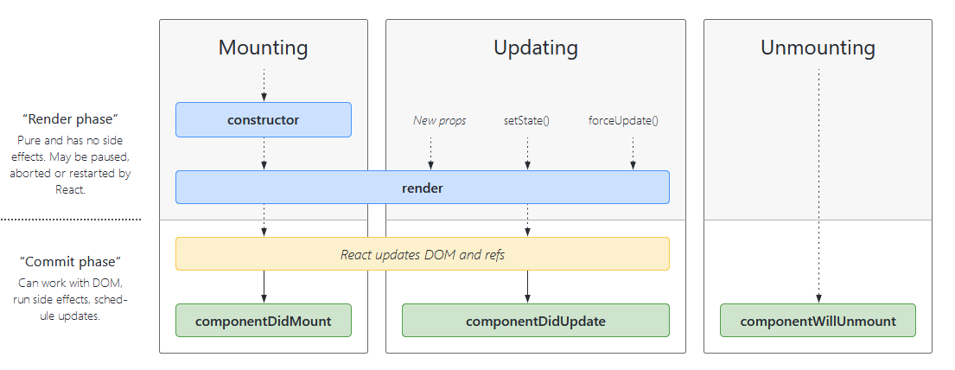

Slide 8
constructor
JS constructor.
Declare state and bind context to life cycle events.
Do not call setState.
Always call super(props) to bind this.props.

Slide 9
render
Rendering of the component.
Called everytime state or props are getting changed.
Can return JSX, Portal, Fragments, Strings, boolean etc.

Slide 10
componentDidMount
Fires after component is mount to DOM.
Can interact with DOM.
Ajax calls and update the state.

Slide 11
getDerivedStateFromProps
Use this if you want to update your state from props.
React highly recommends not to use this.
Highly discourage conditionally setting state from props.

Slide 12
shouldComponentUpdate
To decide whether to update the component or not.
Only as a performance enhancement, if required.

Slide 13
componentDidUpdate
After component got updated.
Will not run if shouldComponentUpdate return false.
Use this to interact with DOM after a Component update.

Slide 14
componentWillUnmount
Before removing the Component.
Should not call setState.
Clean up tasks.

Slide 15
getDerivedStateFromError/componentDidCatch
After an error from decedent component.
getDerivedStateFromError to get error related State.
componentDidCatch for logging and side effects.

Slide 16
Context API
Relatively new API.
Main purpose to avoid passing props via multiple levels.
This usage is clearly defined by React as it should be only used to context level data. Ex: authenticated users, theme
This should not be used as state holder.
Controlling the rendering is comparatively hard.

Slide 17
Hooks
Relatively new feature.
This is a way to introduce state, some life cycles to functional components.
This feature is being extensively used to add new features to functional components.
Hooks should only be used at the top level (not in loops etc.) and should only be used in React functional components and custom hooks.
There are mainly two popular hooks
useState
useEffect
Other
useContext
useReducer

Slide 18
Babel
Most popular JavaScript transpiler.
Convert JavaScript es6 features and beyond to latest compatible version.
Babel polyfills are available to support new global objects. It uses core-js polyfills.
So far Babel compatibility with new features has been one of the best.
Debugging enabled via source maps.
In built code optimization.
Supports JSX (XML like syntax extension) and FLOW (Static type checker).

Slide 19
Webpack
Most famous module bundler.
Support for build system as well as module bundling.
Split code into multiple files.
Supports CommonJS and AMD.
Extend using loaders (transpiling, css transformation, image optimization).
Supports production optimizations (minification, uglification).
Easy configuration with 4 steps - entry -> loaders -> plugins -> output.

Slide 20
Parcel
Fastest module bundler.
Relatively new to community.
Conventions over configurations.
Support JSX, SCSS, LESS, SVG, TypeScript etc.
Plugins available for extension and plugins are automatically detected.

Slide 21

Let’s try this out

Slide 22
Setting up
Create a node project.
npm init
Install parcel and babel related dependencies.
npm install parcel@next –save-dev
Install React related dependencies.
npm install react react-dom --save

Slide 23


